Slide 1


UNIT 1: Time for school
All about me

Slide 2
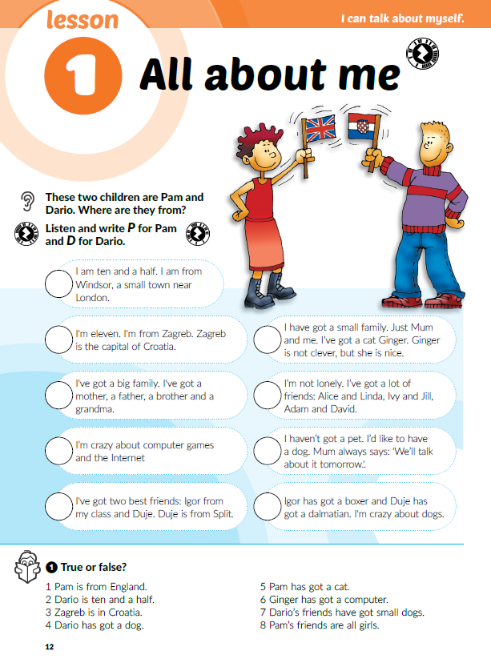

Let’s get familiar with the book.
Scan the QR codes in your book

Slide 3

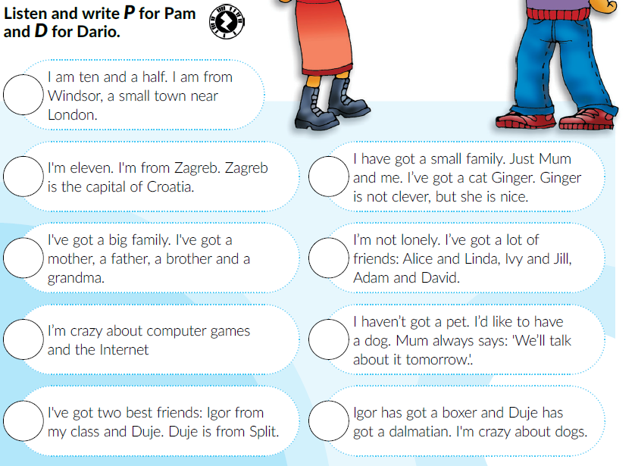

Look at the picture on page 12.
Who do you think they are?
Where are they from? Look at the flags.
Let’s check!
P
Listen and write P for Pam and D for Dario.
D
P
D
P
P
D
D
D

Slide 4
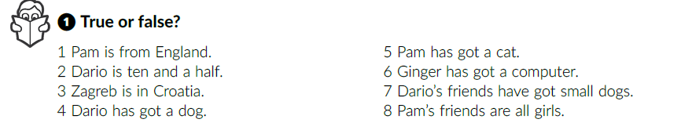
Listen again. Are the sentences true (T) or false (F)?
T
T
F
F
T
F
F
F

Slide 5
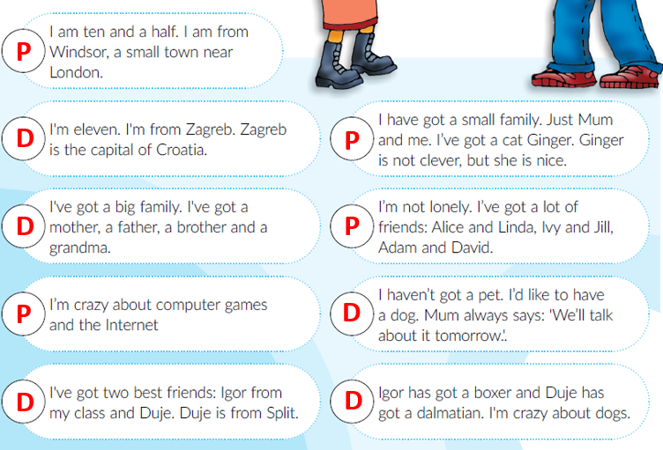
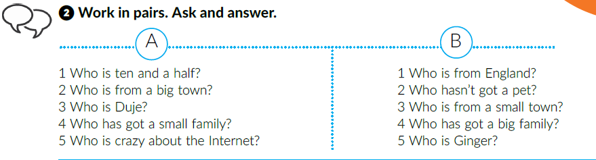
Work in pairs. Ask and answer.
Read the text out loud.

Slide 6
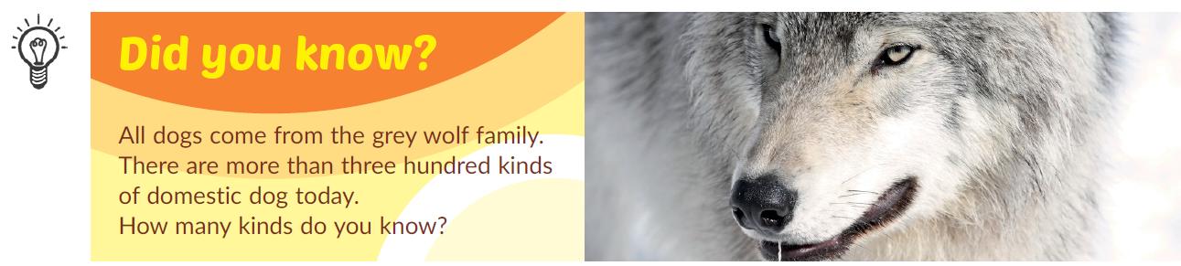
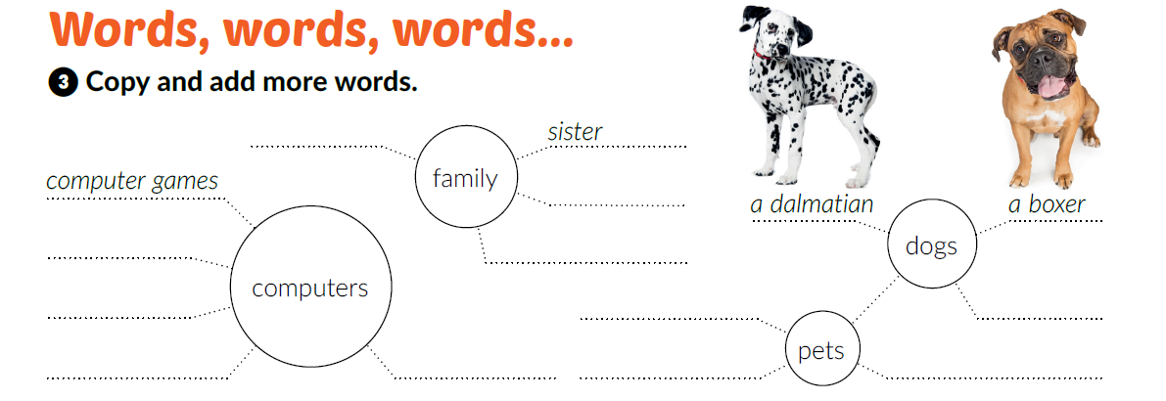
How many kinds of domestic dogs do you know? Add your ideas on the line, next to the category dogs.
Work in groups. Write the words that fit each of the following categories (computers, family, pets).
B, p.13

Slide 7
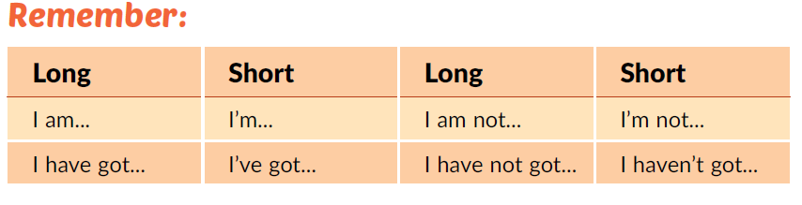
Look at the Remember box!
What’s the difference between ‘‘I am’’ and ‘‘I have got”?

Slide 8
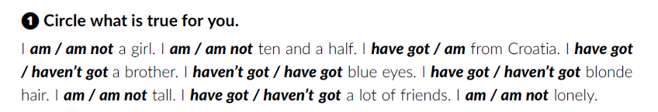
Open your workbook at page 5.
Do task 1.

Slide 9
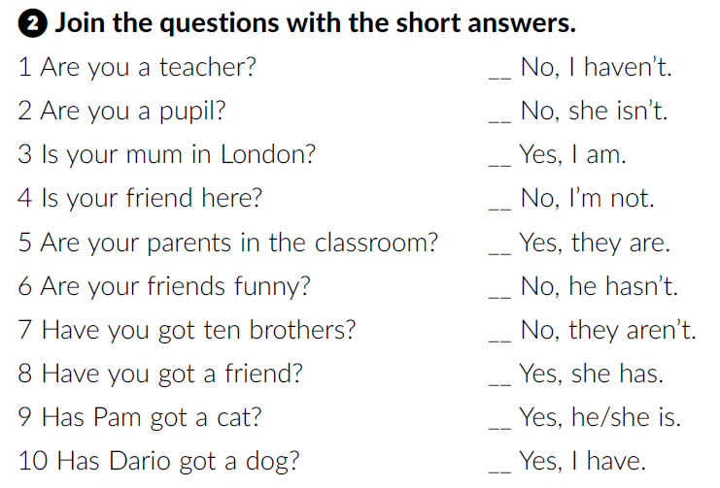
Join the questions with the short answers.
7
3
2
1
6
10
5
9
4
8

Slide 10
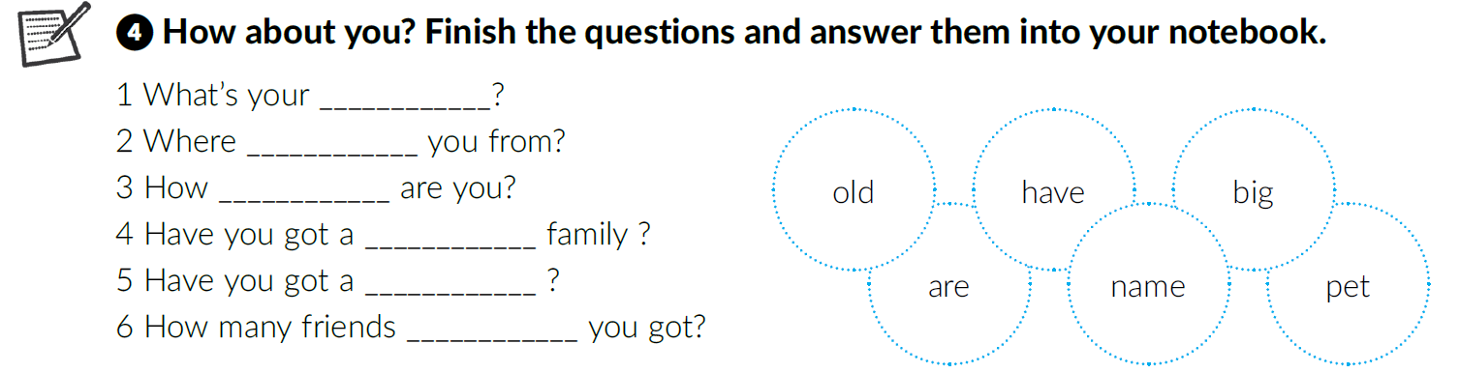
Go to your book, page 13.
Use the words in circles and finish the questions.
name
are
old
big
pet
have
Then, work in pairs. Ask your partner about him/her and answer the questions about yourself.

Slide 11

Click on the following link and play the game ‘‘Mysterious you’’.
https://wordwall.net/resource/237334/mysterious-you-reveal-your-secrets-talk-about-yourself
Click on the following link and choose ‘‘Learn more”. Read the text Dario’s hometown.
https://www.e-sfera.hr/dodatni-digitalni-sadrzaji/c94d868a-a3be-4d7e-8968-eb8de06794be/

Slide 12
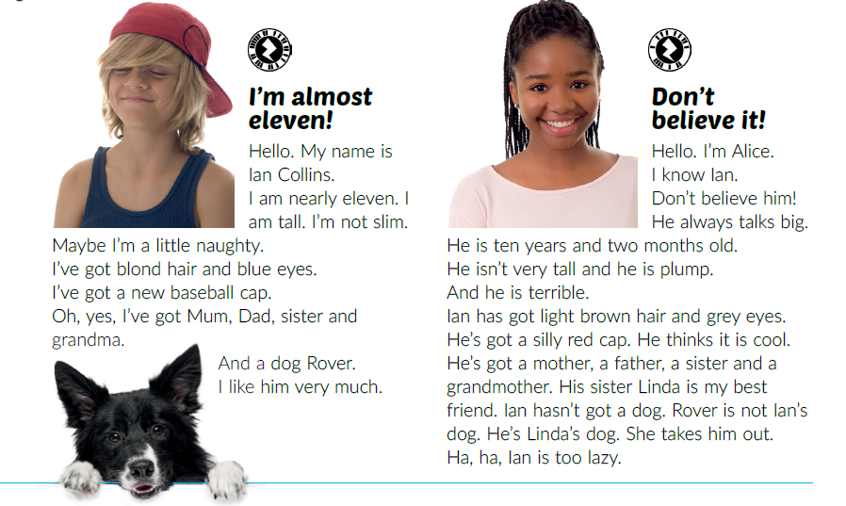
Open your book at page 14.
Do you know the meaning of the following words?
almost
naughty
don’t believe it
talk big
Listen to Ian and Alice. Answer the questions.
Who are Linda and Rover?
Who talks big?
Is Linda Alice’s sister?

Slide 13
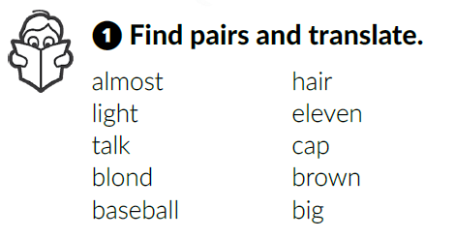
Listen again and do task 1.
Copy the expressions in your notebook and translate them.
In pairs, read the text out loud.

Slide 14
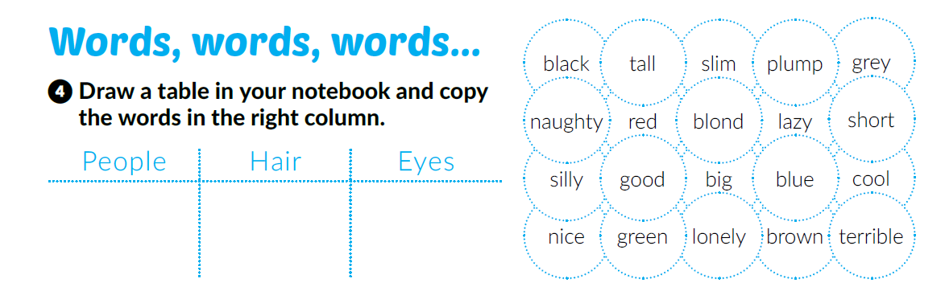
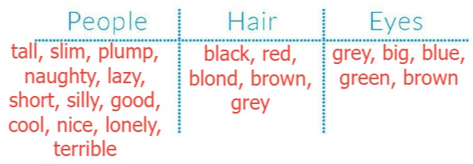
Read the words in task 4. If you don’t know the meaning of the word in the circle, colour that circle.
Copy the table in your notebook and copy the words in the right column.

Slide 15
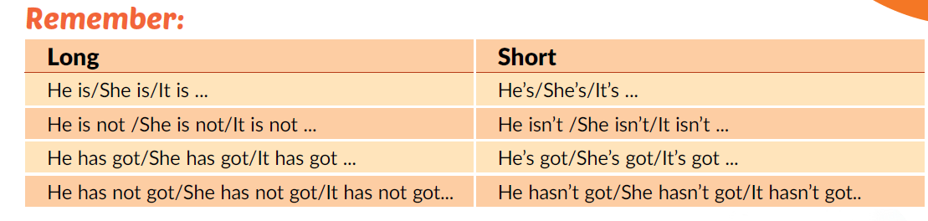
Look at the ‘‘Remember” box on page 15.
Click on the following link and complete the task. Sort out the words and make sentences.
https://learningapps.org/view5192259

Slide 16
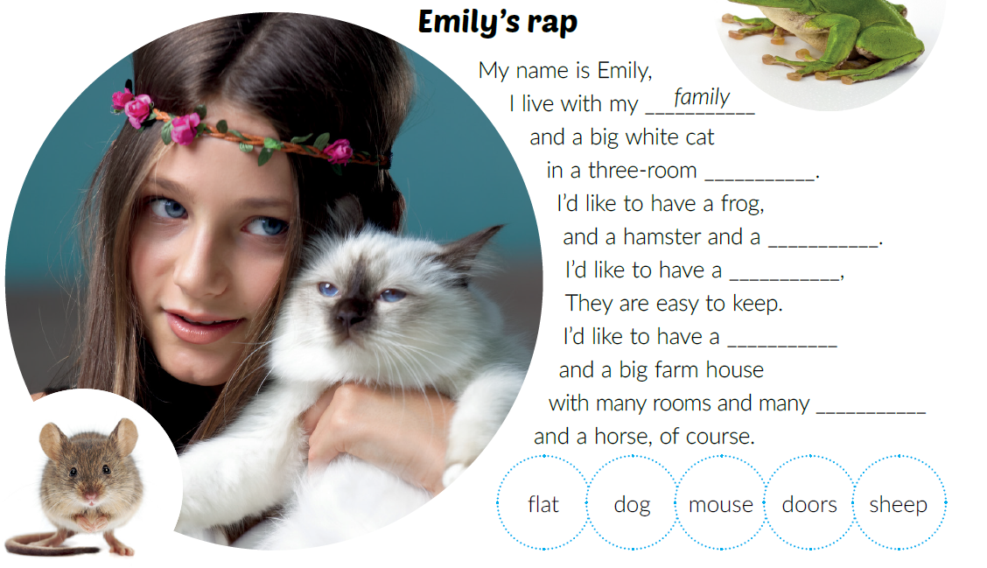
Listen to the song Emily’s rap and follow the beat.
Fill in the gaps with the correct word.
flat
Listen and read out the last word only.
dog
sheep
mouse
Listen and sing along.
doors

Slide 17
Click on the following link and choose ‘‘Self check”. Complete the task.
https://www.e-sfera.hr/dodatni-digitalni-sadrzaji/c94d868a-a3be-4d7e-8968-eb8de06794be/

Slide 18
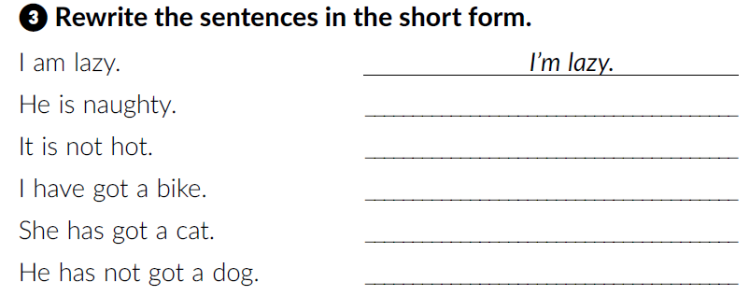
Open your workbook at pages 5 and 6.
He’s naughty.
It isn’t hot.
I haven’t got a bike.
She’s got a cat.
He hasn’t got a dog.

Slide 19
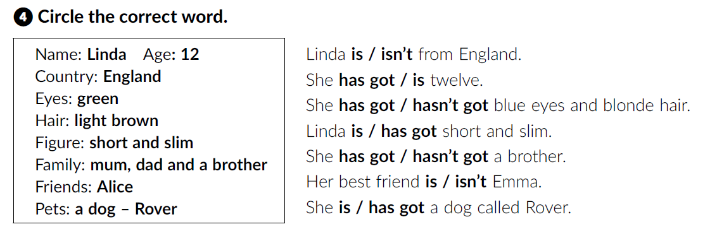
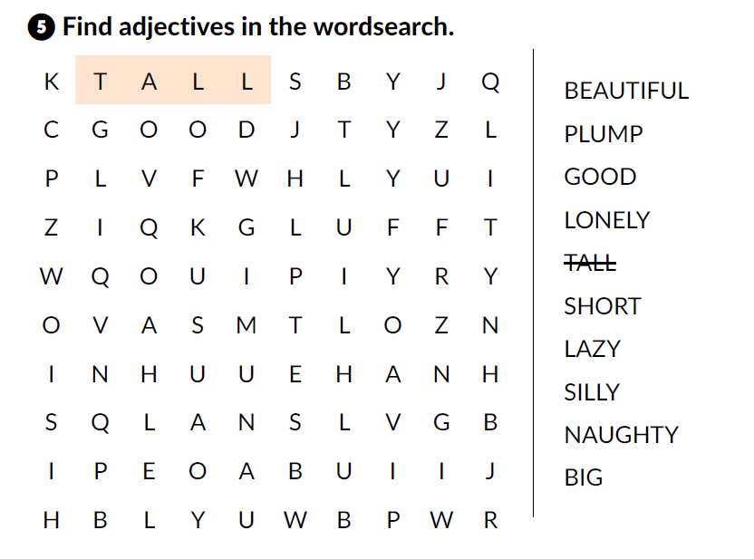
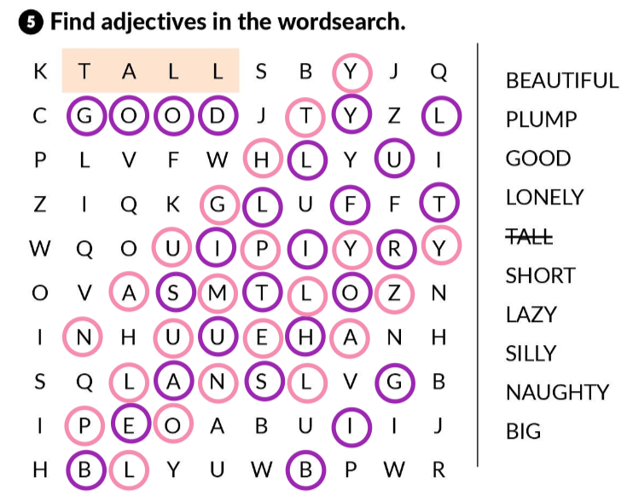

Slide 20
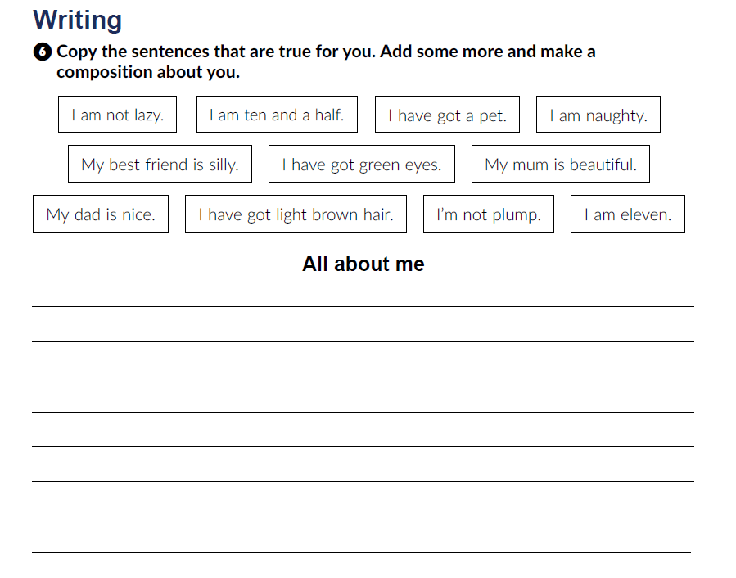


Slide 21
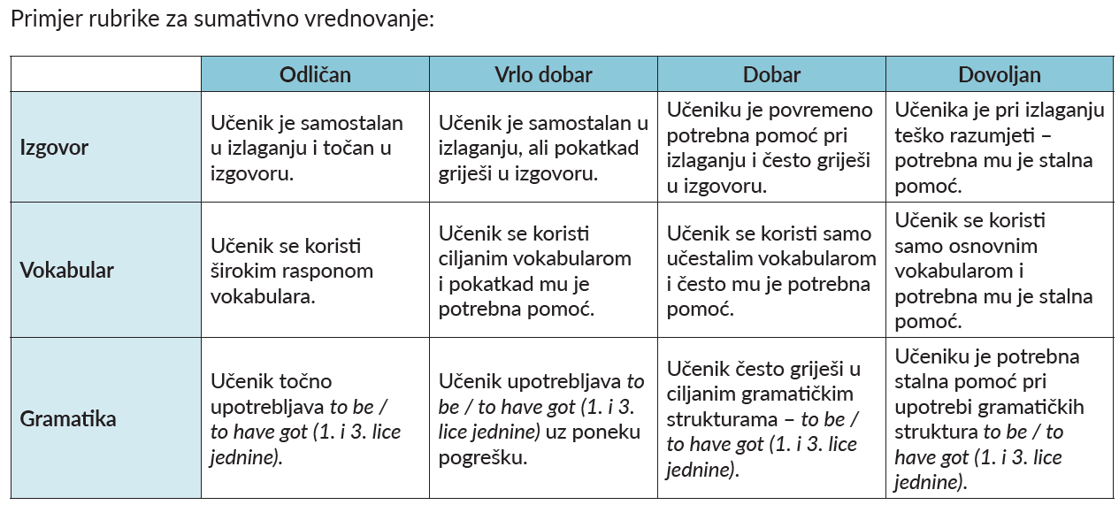
You’re going to describe your family member. Look at the rubric.

Slide 22
Describe your family members to your partner. Then, listen to him/her describing his/her family member. Give him/her your feedback.
Present your mini project.

Slide 23
Click on the following link and complete the task.
https://wordwall.net/play/4439/073/117
Click on the following link and choose ‘‘Learn more”. Read the text All about my family and answer the questions.
https://www.e-sfera.hr/dodatni-digitalni-sadrzaji/c94d868a-a3be-4d7e-8968-eb8de06794be/

